Slide 1
16.82 Flight Vehicle Engineering Introduction and Design Challenge
Fall 2002

Slide 2
Aircraft Early Development Process (Simplified)
Market (RFP) and
Opportunity
Analysis
Requirements
Authority
To
Offer
Conceptual
Development
Concepts
Preliminary
Design
PD & Issues
Detailed
Design
Prototyping
Testing
Cert
Production

Slide 3
Technology Driven Opportunity Space
Electric Vehicles
Zero Emission
Distributed Electric Propulsion
Lightweight Powerful Control Systems
Lightweight sensors, processors, algorithms
Advanced Geometries
Materials and manufacturing
Composites
CNC Molds
3D Printing
Integrated Design Techniques
______________________

Slide 4
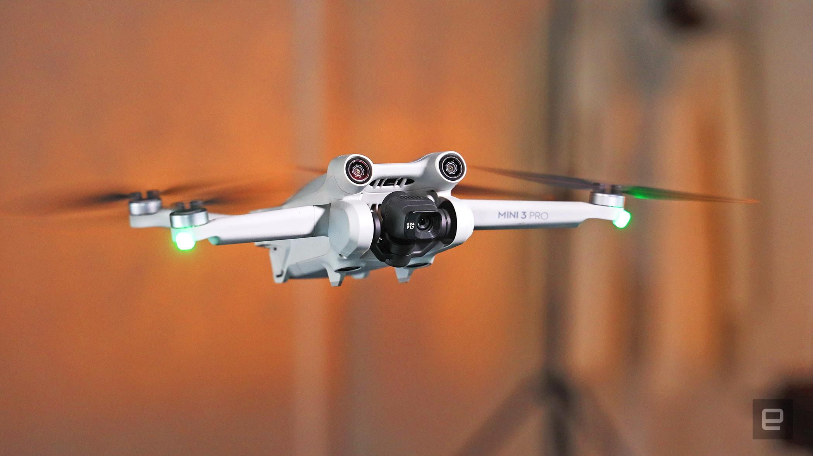
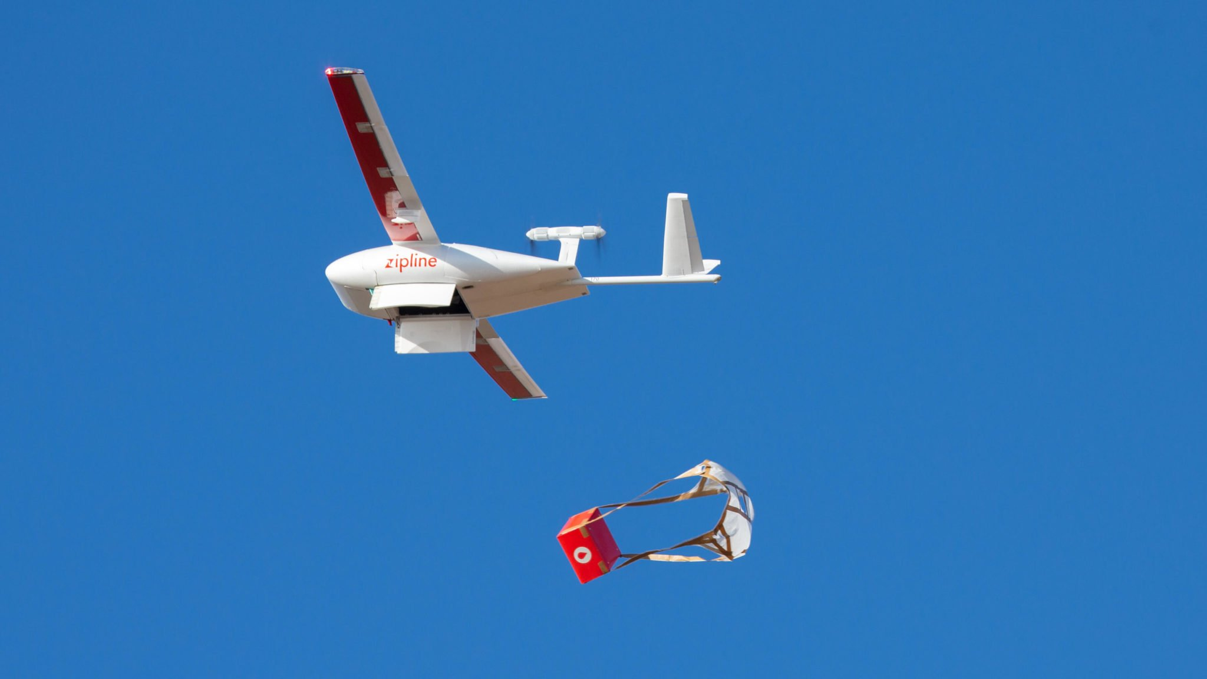
Technology Driven Opportunity Space
Electric Vehicles
Zero Emission
Distributed Electric Propulsion
Lightweight Powerful Control Systems
Lightweight sensors, processors, algorithms
Advanced Geometries
Materials and manufacturing
Composites
CNC Molds
3D Printing
Integrated Design Techniques
______________________
Unmanned Air Vehicles

Slide 5
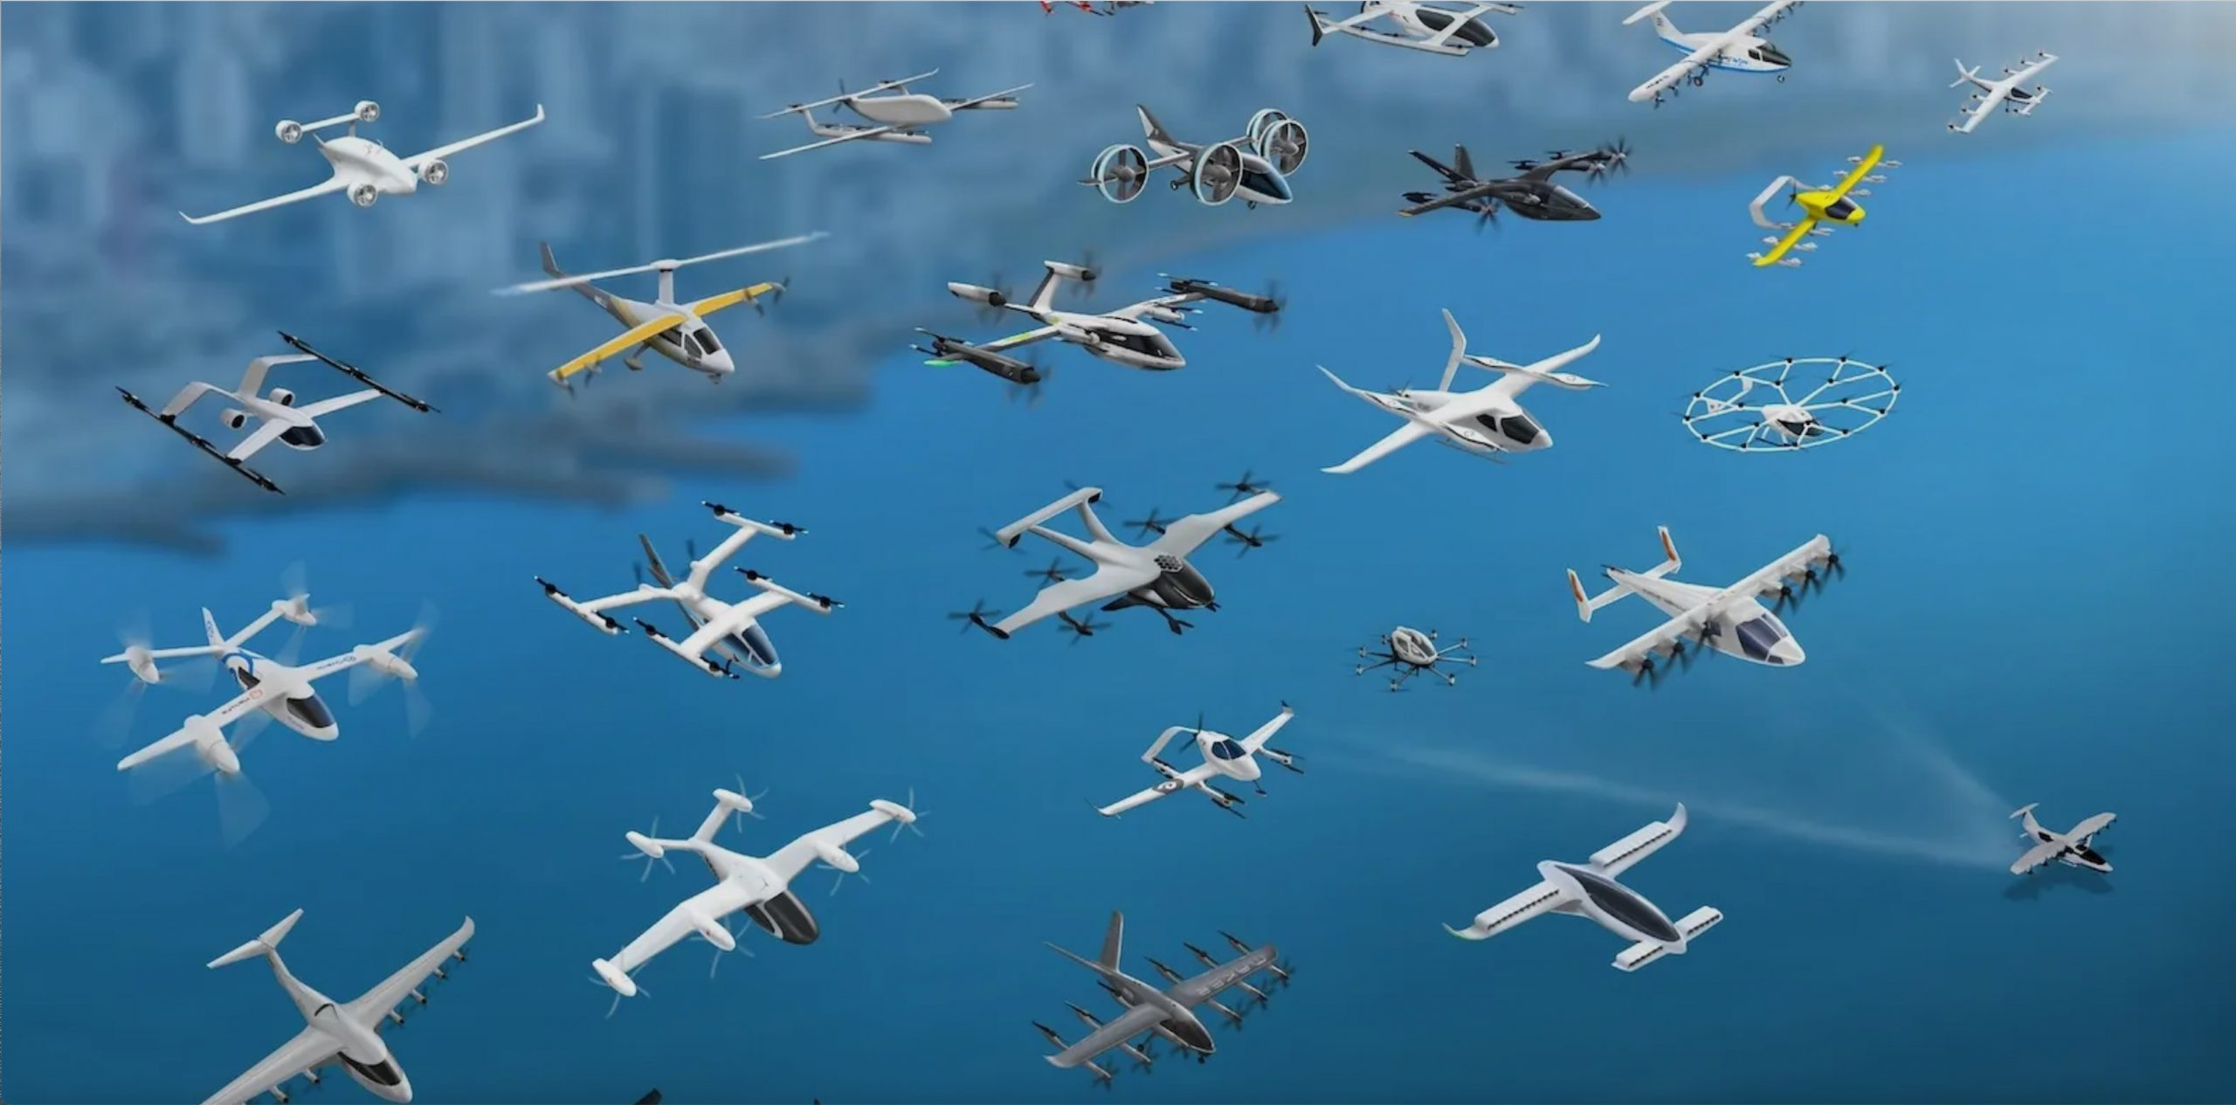
Technology Driven Opportunity Space
Electric Vehicles
Zero Emission
Distributed Electric Propulsion
Lightweight Powerful Control Systems
Lightweight sensors, processors, algorithms
Advanced Geometries
Materials and manufacturing
Composites
CNC Molds
3D Printing
Integrated Design Techniques
______________________
Unmanned Air Vehicles
Advanced Air Mobility
eVTOL, eSTOL, eCTOL

Slide 6
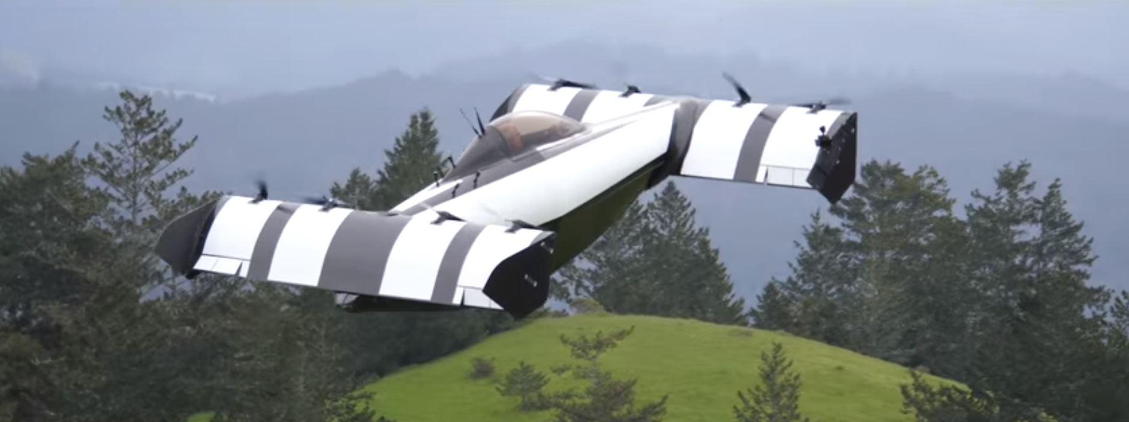
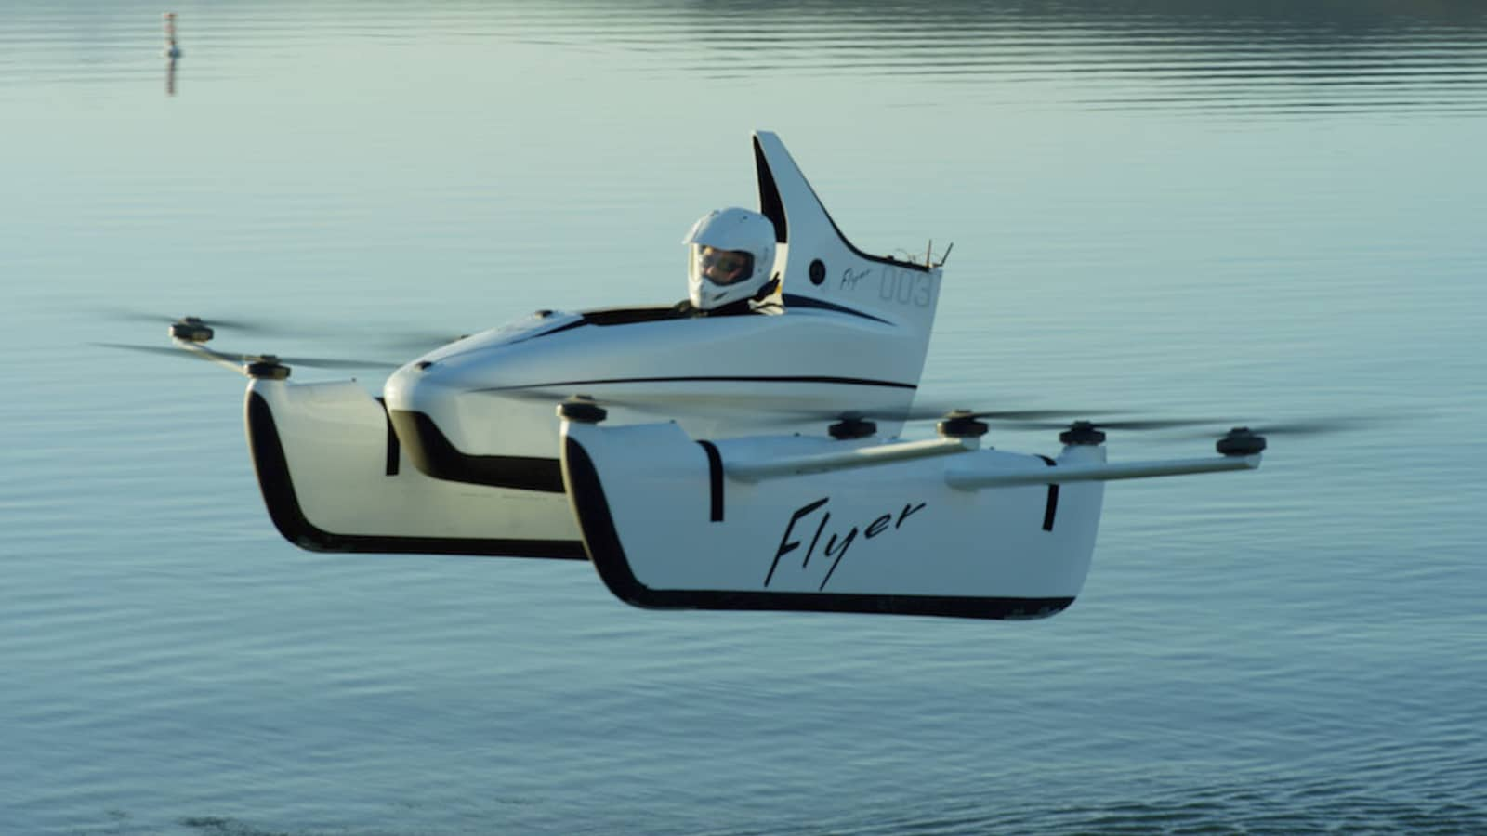
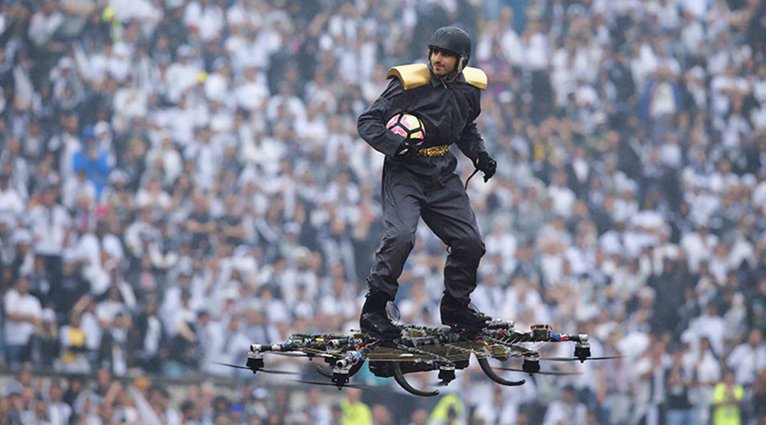
Technology Driven Opportunity Space
Electric Vehicles
Zero Emission
Distributed Electric Propulsion
Lightweight Powerful Control Systems
Lightweight sensors, processors, algorithms
Advanced Geometries
Materials and manufacturing
Composites
CNC Molds
3D Printing
Integrated Design Techniques
______________________
Unmanned Air Vehicles
Advanced Air Mobility
eVTOL, eSTOL, eCTOL
Personal Sport Air Vehicles

Slide 7
Course Objective
Conceive and Design a Zero-Emission Personal Sport Air Vehicle
Open design space to maximize flexibility for “interesting”, innovative or marketable designs.
Teams can define their own mission and performance targets
Target unregulated single person “ultralight” category

Slide 8
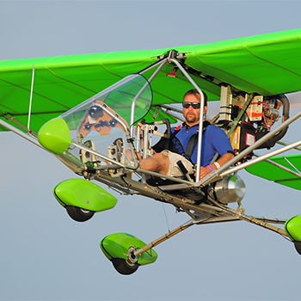
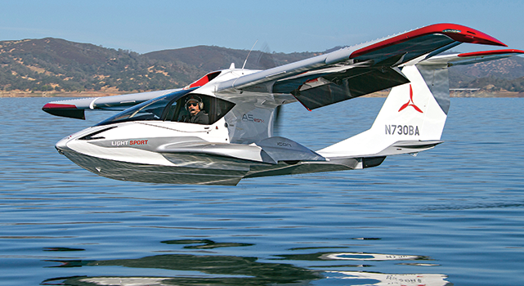
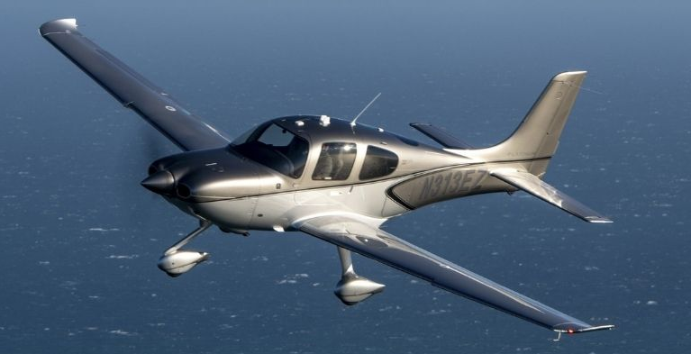
US Small Aircraft Categories
Light Sport Aircraft
(Order 8130.2)
Ultralight
(FAR Part 103)
Unregulated
Conventional GA
(FAR Part 23)

Slide 9
US Small Aircraft Categories
Ultralight (Part 103)
1 person
<254 lbs empty weight max
< 5 gal
Max CAS < 55kts
Power off Stall < 24kts
Light Sport Aircraft (Part 103)
< 2 person
MTOW < 1320 lb land, 1430 lb seaplane
Max CAS < 120kts
Power off Stall < 24kts
Not electric (single recip) but EASA has certified Pipstral by special condition
Not powered lift
Conventional General Aviation Part 23 (small aircraft, not powered lift)
14 CFR 21.17(b) “Special Class” (path for eVTOL)

Slide 10
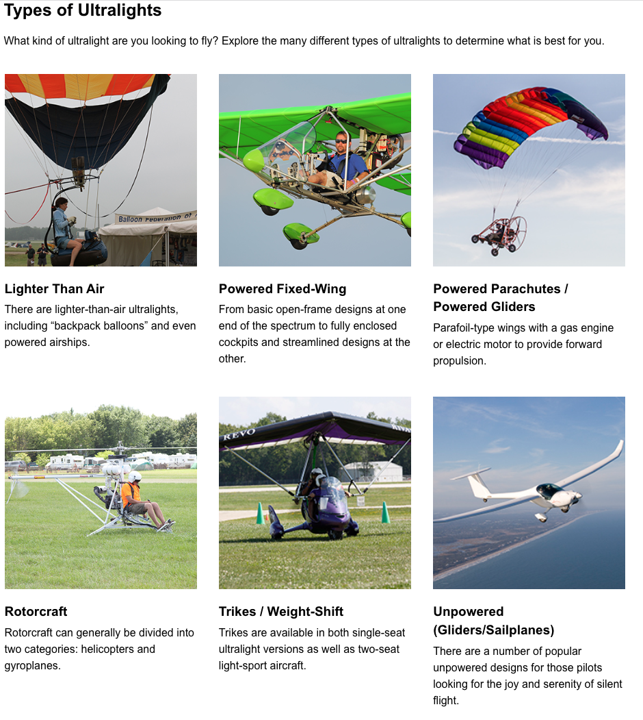
Experimental
Aviation
Association
Classic Ultralights
https://www.eaa.org/eaa/aviation-interests/ultralights/getting-started-in-ultralight-flying/types-of-ultralights

Slide 11
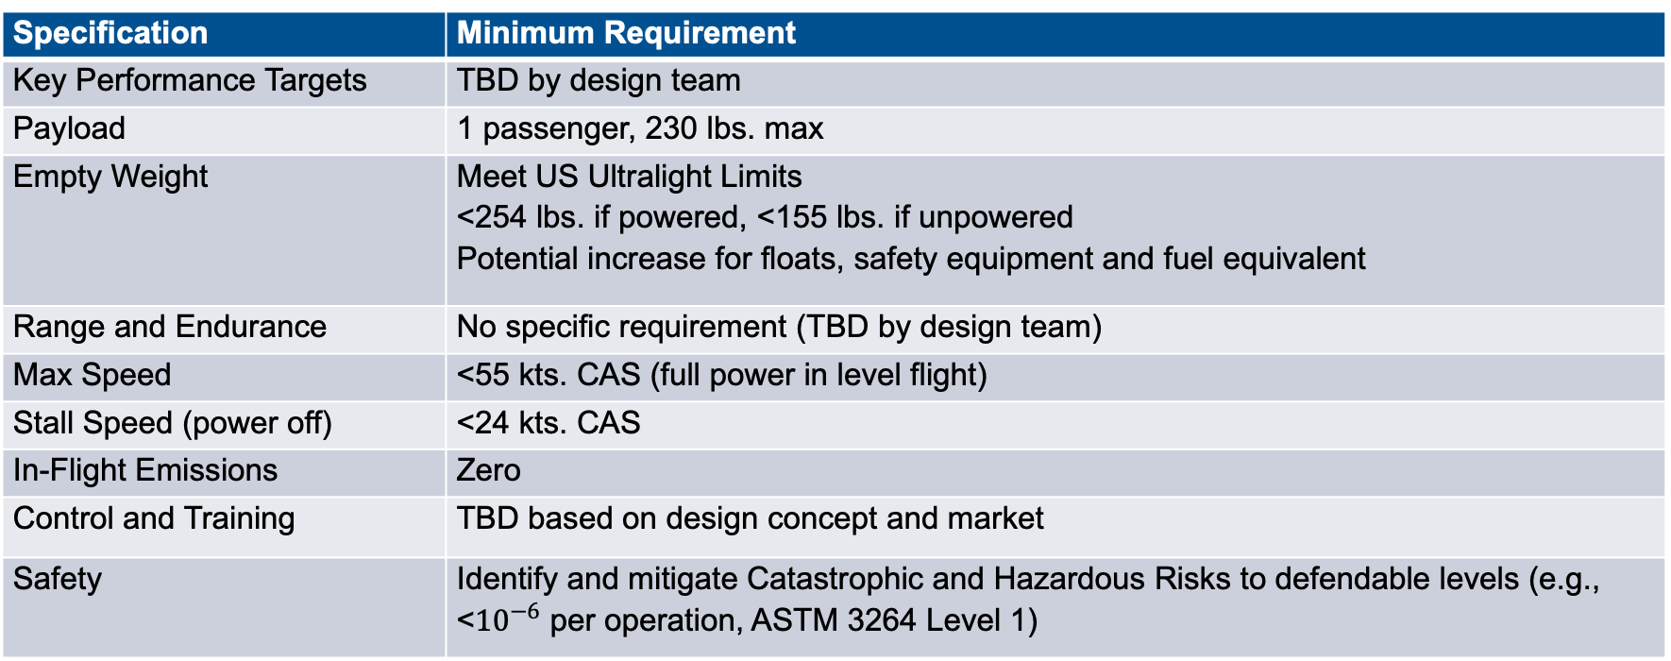
Baseline System Specifications
Specification | Minimum Requirement
Key Performance Targets | TBD by design team
Payload | 1 passenger, 230 lbs. max
Empty Weight | Meet US Ultralight Limits <254 lbs. if powered, <155 lbs. if unpowered Potential increase for floats, safety equipment and fuel equivalent
Range and Endurance | No specific requirement (TBD by design team)
Max Speed | <55 kts. CAS (full power in level flight)
Stall Speed (power off) | <24 kts. CAS
In-Flight Emissions | Zero
Control and Training | TBD based on design concept and market
Safety | Identify and mitigate Catastrophic and Hazardous Risks to defendable levels (e.g., <${10}^{−6}$ per operation, ASTM 3264 Level 1)

Slide 12
Syllabus Discussion
Market (RFP) and
Opportunity
Analysis
Requirements
Authority
To
Offer
CoDR
Conceptual
Development
Concepts
PDR, CDR
Preliminary
Design
PD & Issues
Detailed
Design
Prototyping
Testing
Cert
Production

Slide 13
Opener Blackfly
https://opener.aero/
Amphibious eVTOL

Slide 14
Omni Hoverboard

Slide 15
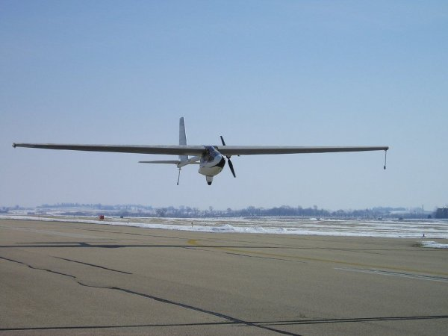
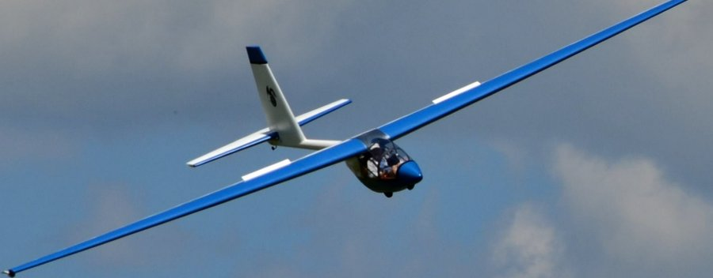
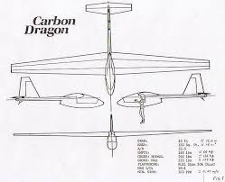
Carbon Dragon
Empty Weight 148 lbs
Foot launch and electric variants

Slide 16
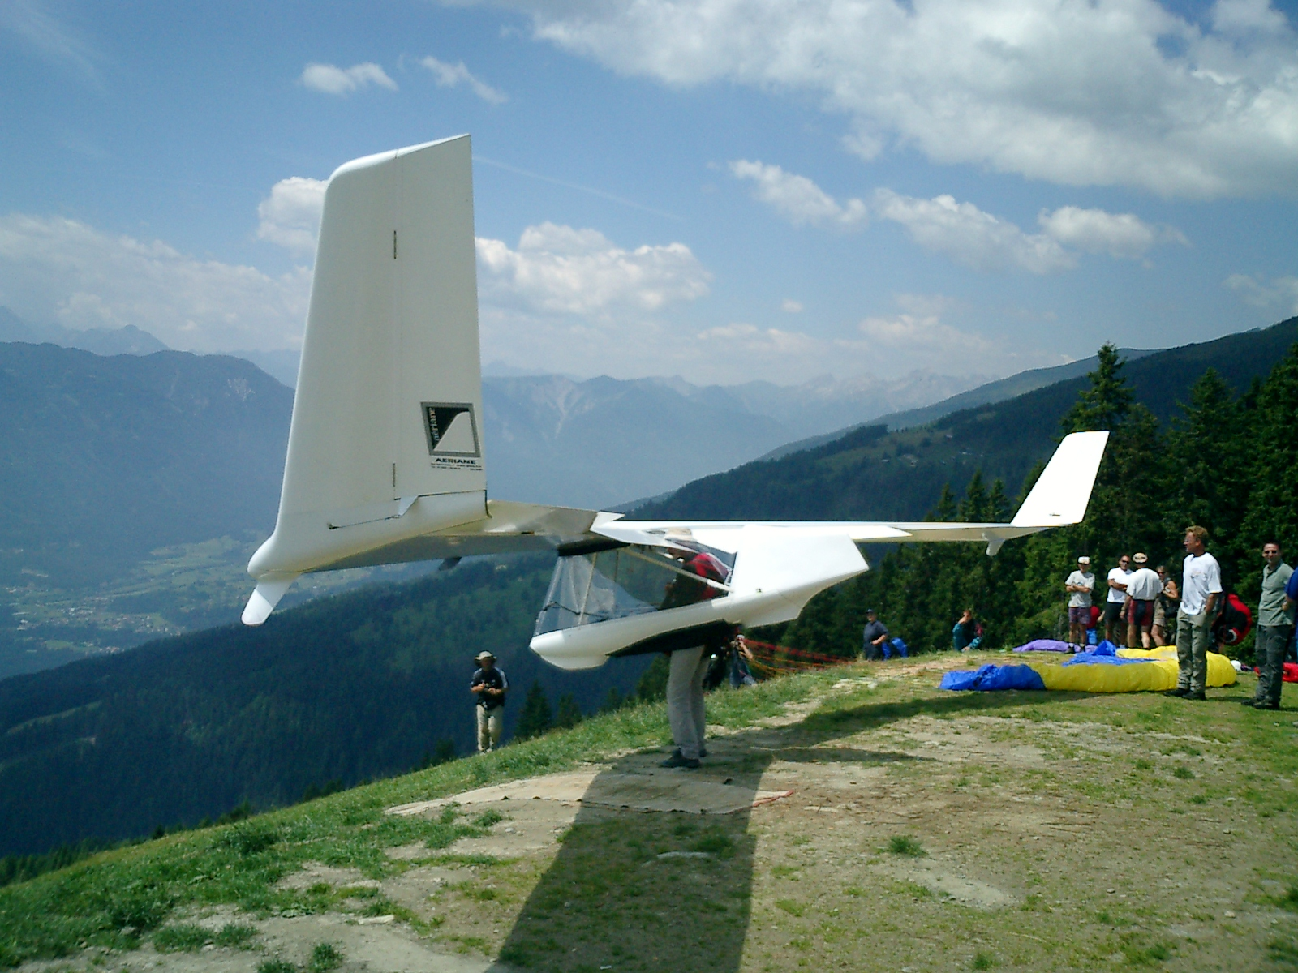
Aeriane Swift
Glider Empty Weight 106lbs

Slide 17
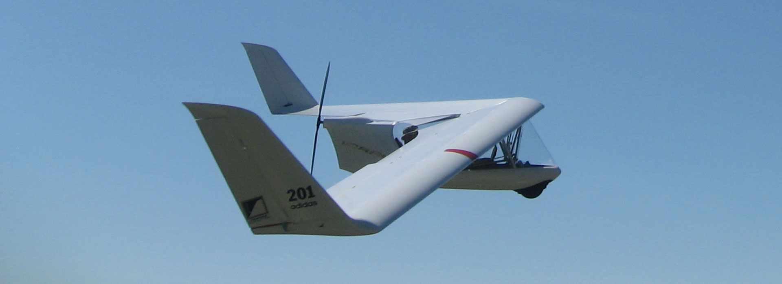
Electric Swift
Glider Empty Weight 106lbs

Slide 18
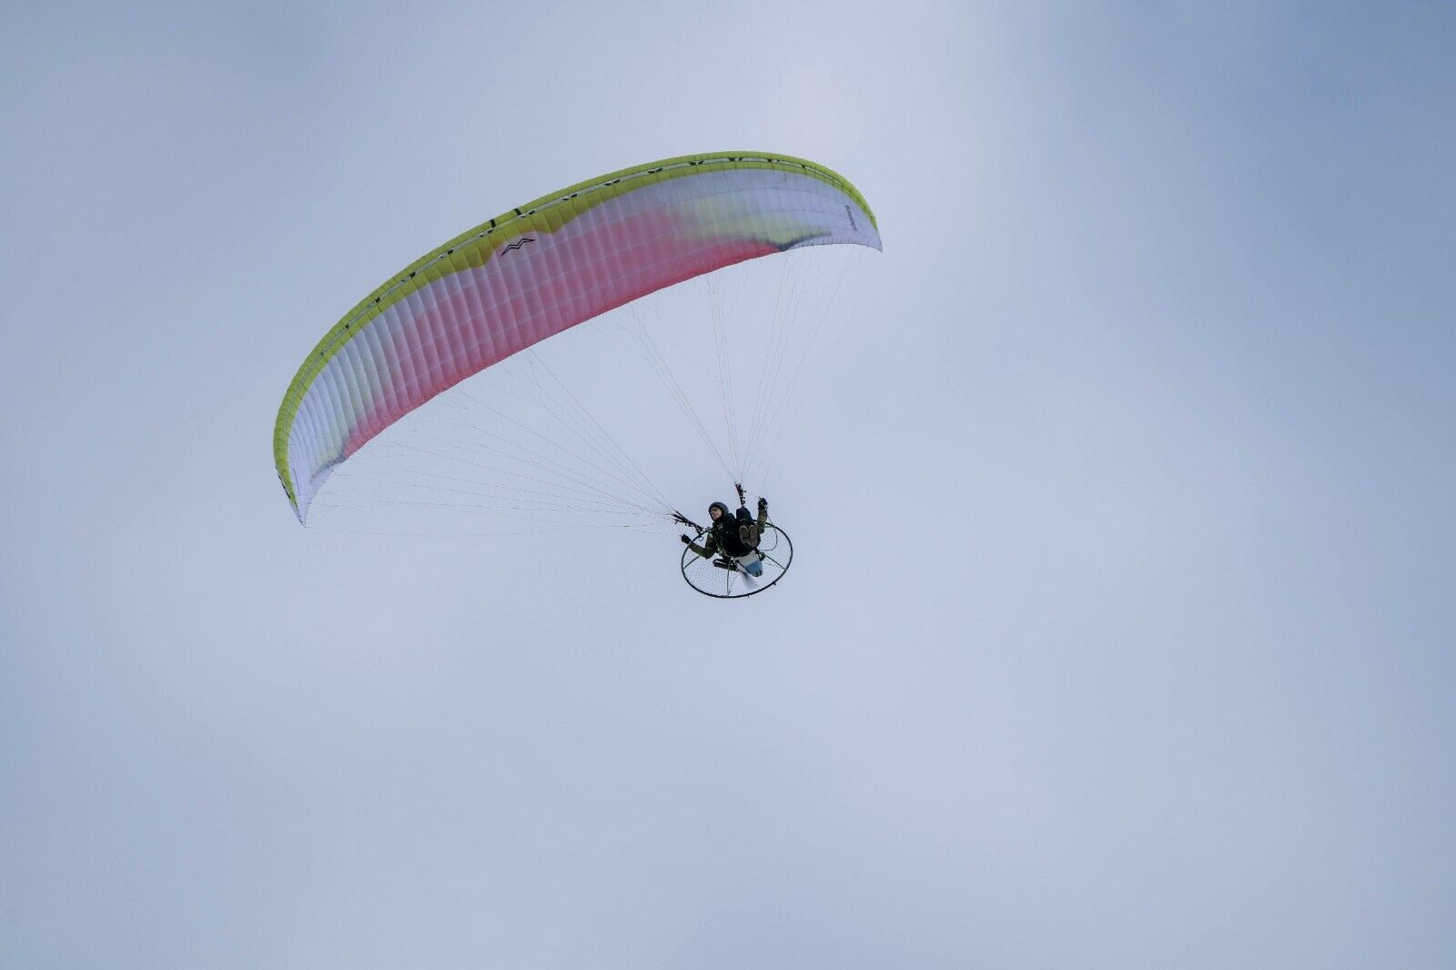
Powered Parachutes

Slide 19
Kitty Hawk Flyer

Slide 20
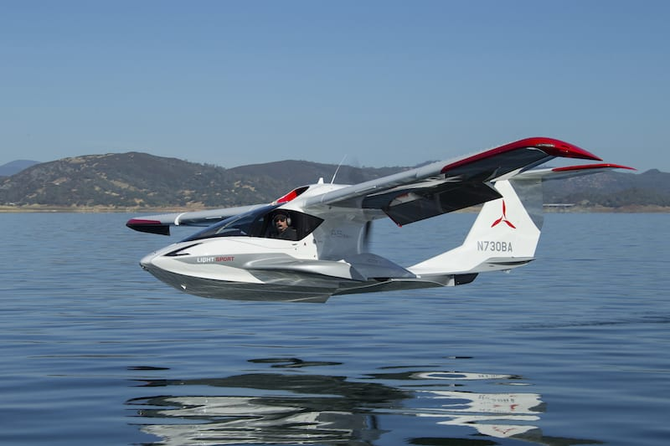
Icon A5 LSA

Slide 21
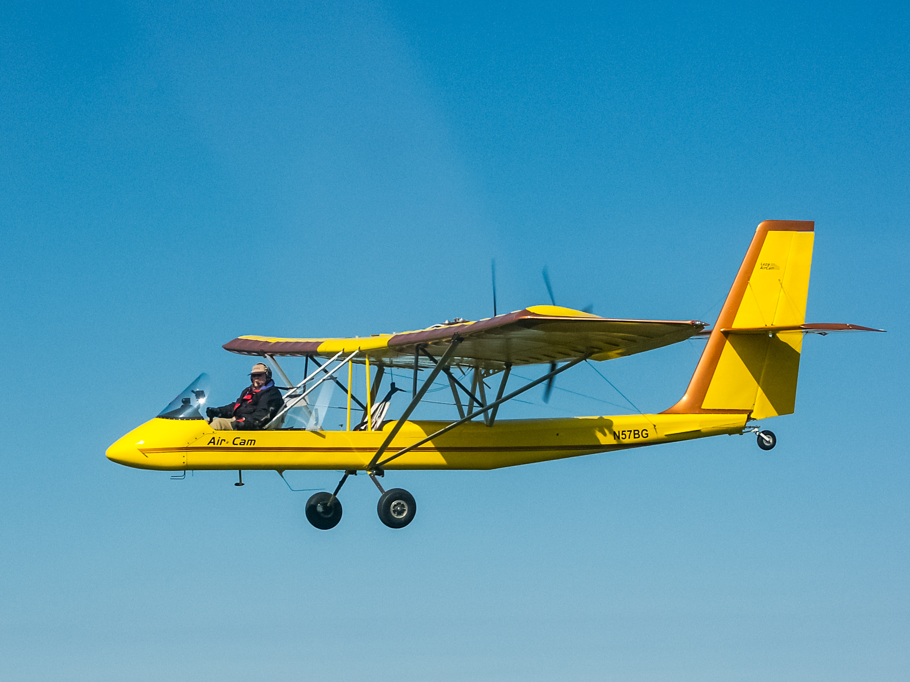
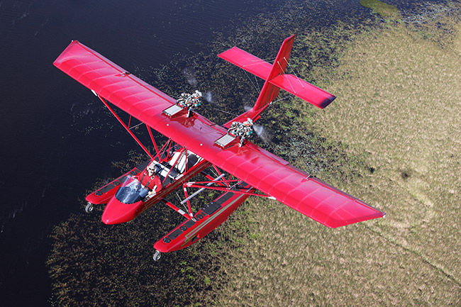
Air Cam

Slide 22
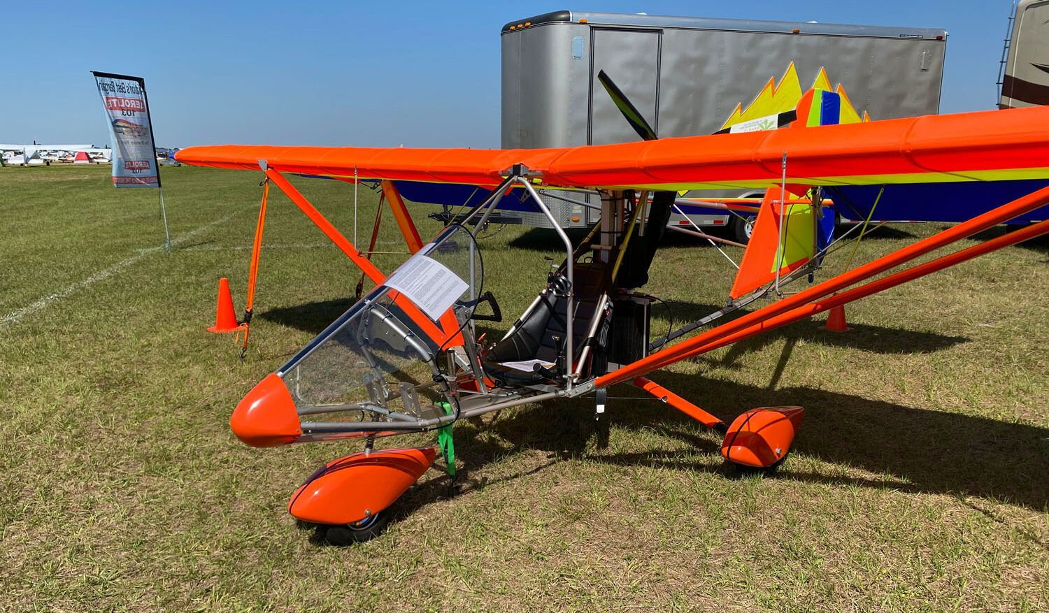
Aerolite EV103 Electric

Slide 23
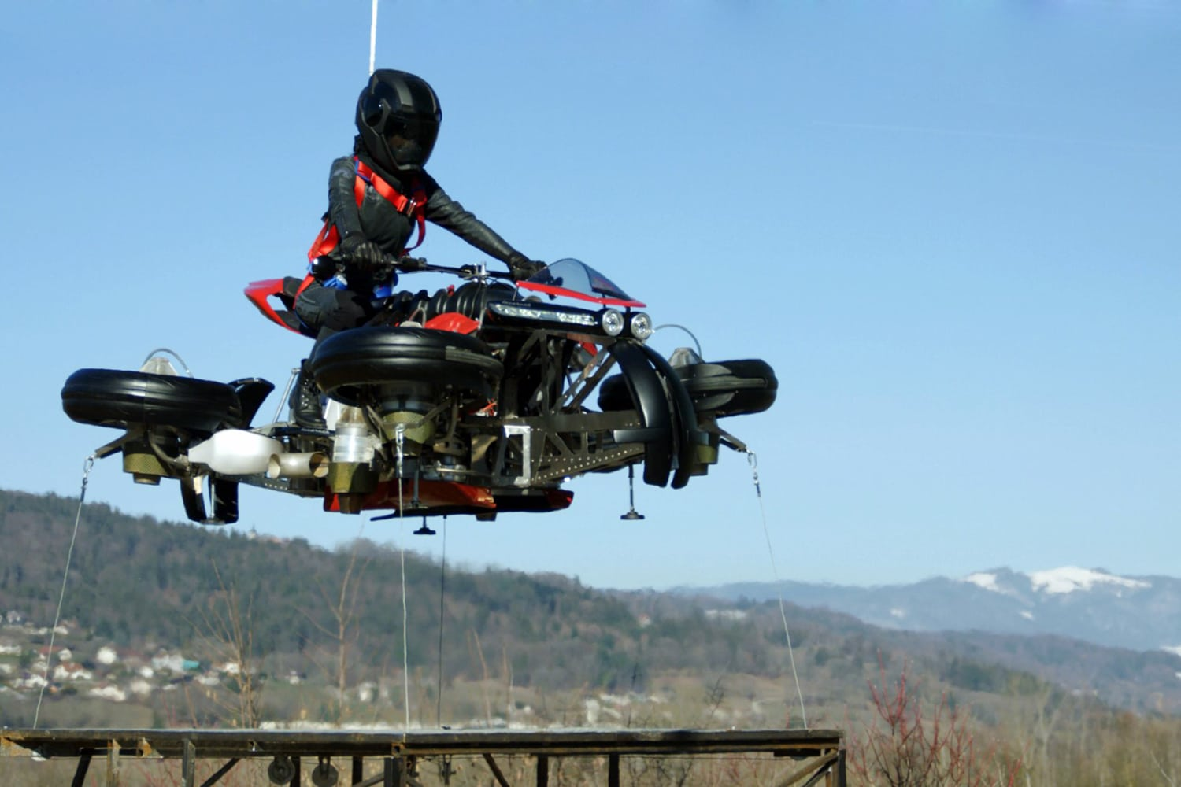
Lazareth LMV 496

Slide 24
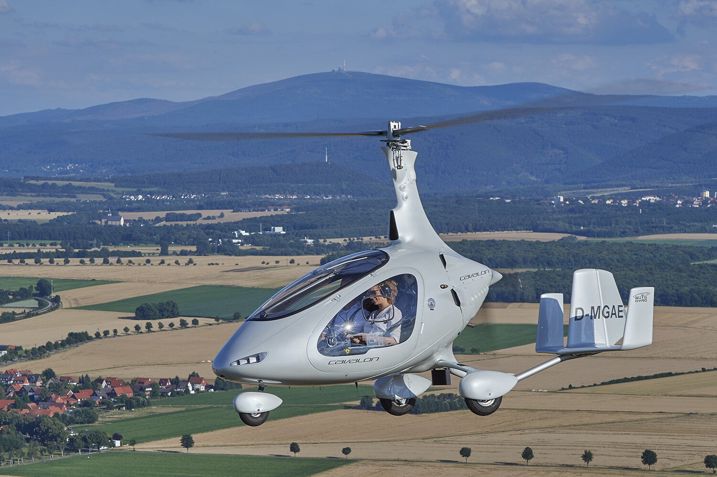
Autogyros

Slide 25
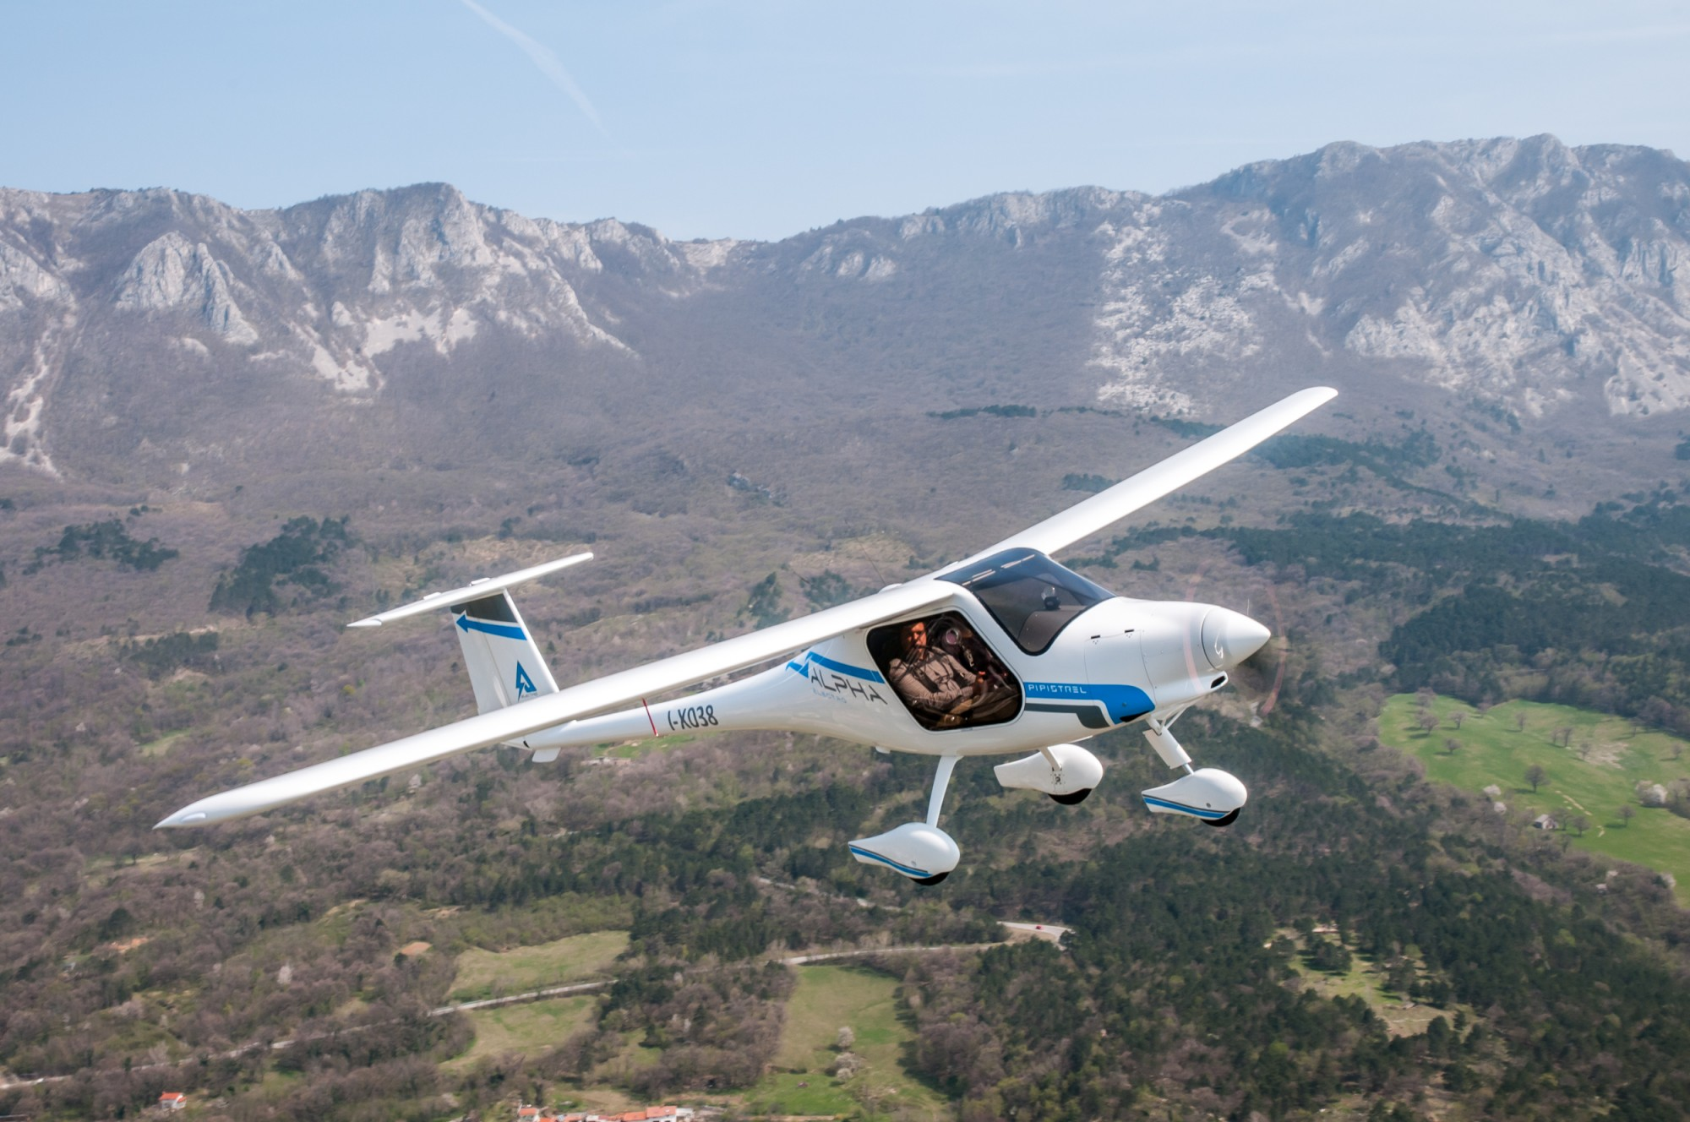
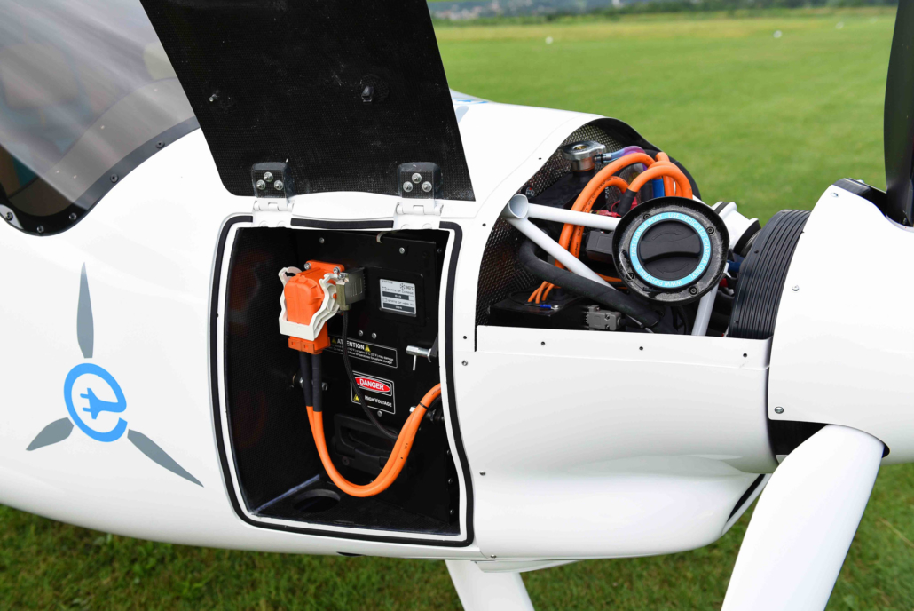
Pipistral Alpha Electro (LSA)
EASA Certified LSA
Special Condition?

Slide 26
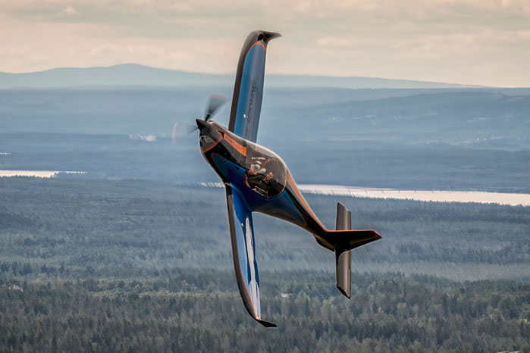
Blackwing Electric Aerobatic (LSA)

Slide 27
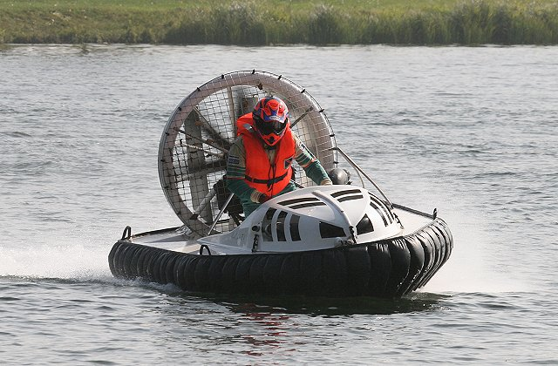
Hovercraft

Slide 28
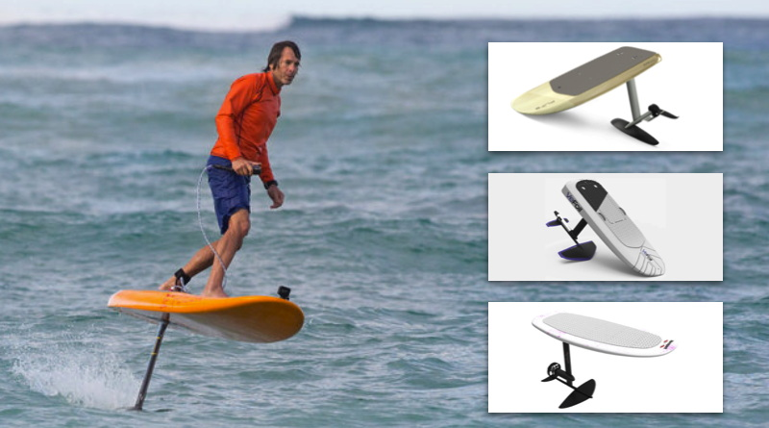
Electric Hydrofoils

Slide 29

May be consistent with GoFly Competition

Slide 30
Break for Team Formation

Slide 31
Brainstorming
Brainstorming Prep
Understanding of what you are trying to do
Market, Mission (Analysis)
Will drive requirements
Understanding of Opportunities
Technology
Markets
Understanding of Competition and Similar Solutions
Comparative Analysis of Competitive Solutions
Brainstorming Rules
No criticism in the first pass
Capture ideas
Feed off of other ideas
Think out of the box
Review ideas after first pass
Reject Infeasible Ideas - “Unobtanium”
Evaluate remaining Options
For this problem may want to separate out market /requirements brainstorming from solution brainstorming

Slide 32
Missions and Markets
Transport
Short Range
Long Range
Remote
Water
Exploration
Photography
Sightseeing
Training
Inspection and Monitoring
Extreme Experiences
Exclusivity
…

Slide 33
Performance Requirements?
Payload
Range
Speed
Fast
Slow
Takeoff and Land
Surface
Distance
Obstacles
Maneuverability
Rates
G loads
Aerobatics
Training and Automation

Slide 35
Systems Engineering “V” Process Will Experience in This Project

Slide 36
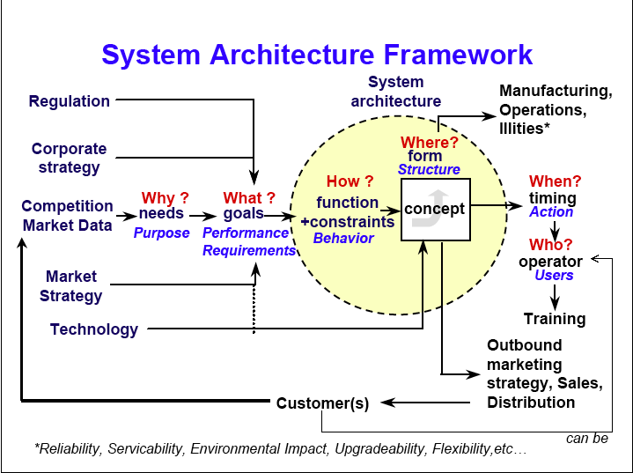
Source: JP Clarke, 16.886

Slide 37
Cost of System Change
Source: Fabrycky & Blanchard
Source: Al Haggerty

Slide 38
14 CFR 21.17(b) “Special Class”
(b) For special classes of aircraft, including the engines and propellers installed thereon (e.g., gliders, airships, and other nonconventional aircraft), for which airworthiness standards have not been issued under this subchapter, the applicable requirements will be the portions of those other airworthiness requirements contained in Parts 23, 25, 27, 29, 31, 33, and 35 found by the FAA to be appropriate for the aircraft and applicable to a specific type design, or such airworthiness criteria as the FAA may find provide an equivalent level of safety to those parts.

Slide 39
Ultralight
103.1 Applicability
This part prescribes rules governing the operation of ultralight vehicles in the United States. For the purposes of this part, an ultralight vehicle is a vehicle that:
(a) Is used or intended to be used for manned operation in the air by a single occupant;
(b) Is used or intended to be used for recreation or sport purposes only;
(c) Does not have any U.S. or foreign airworthiness certificate; and
(d) If unpowered, weighs less than 155 pounds; or
(e) If powered:
(1) Weighs less than 254 pounds empty weight, excluding floats and safety devices which are intended for deployment in a potentially catastrophic situation;
(2) Has a fuel capacity not exceeding 5 U.S. gallons;
(3) Is not capable of more than 55 knots calibrated airspeed at full power in level flight; and
(4) Has a power-off stall speed which does not exceed 24 knots calibrated airspeed.
103.7 Certification and registration.
(a) Notwithstanding any other section pertaining to certification of aircraft or their parts or equipment, ultralight vehicles and their component parts and equipment are not required to meet the airworthiness certification standards specified for aircraft or to have certificates of airworthiness.
(b) Notwithstanding any other section pertaining to airman certification, operators of ultralight vehicles are not required to meet any aeronautical knowledge, age, or experience requirements to operate those vehicles or to have airman or medical certificates.
(c) Notwithstanding any other section pertaining to registration and marking of aircraft, ultralight vehicles are not required to be registered or to bear markings of any type.

Slide 40
Light Sport Aircraft
LSA is an aircraft other than a helicopter or powered-lift that since its original certification has continued to meet the following
(1) A maximum takeoff weight of not more than 1,320 pounds (600 kilograms) for aircraft not intended for operation on water; or 1,430 pounds (650 kilograms) for aircraft intended for operation on water.
(2) A maximum airspeed in level flight with maximum continuous power (VH) of not more than 120 knots calibrated airspeed under standard atmospheric conditions at sea level.
(3) A maximum never-exceed speed (VNE) of not more than 120 knots calibrated airspeed for a glider.
(4) A maximum stalling speed or minimum steady flight speed without the use of lift-enhancing devices (VS1) of not more than 45 knots calibrated airspeed at the aircraft’s maximum certificated takeoff weight and most critical CG.
(5) A maximum seating capacity of no more than two persons, including the pilot.
(6) A single, reciprocating engine, if powered.
(7) A fixed or ground-adjustable propeller, if a powered aircraft other than a powered glider. 7/02/2012 8130.2G CHG 1 4-16
(8) A fixed or feathering propeller system, if a powered glider.
(9) A fixed-pitch, semi-rigid, teetering, two-blade rotor system, if a gyroplane.
(10) A nonpressurized cabin, if equipped with a cabin.
(11) Fixed landing gear, except for an aircraft intended for operation on water or a glider.
(12) Fixed or retractable landing gear, or a hull, for an aircraft intended for operation on water. (13) Fixed or retractable landing gear for a glider.
Note: Although gyroplane aircraft (commonly known as gyrocopters) are identified in the LSA definition of 14 CFR § 1.1, gyroplane aircraft, even when meeting the LSA definition, may only be issued an experimental certificate for the purpose of R&D, in accordance with 14 CFR § 21.191(a). Gyroplanes may be eligible in other categories and for purposes other than LSA.

